Slide 1
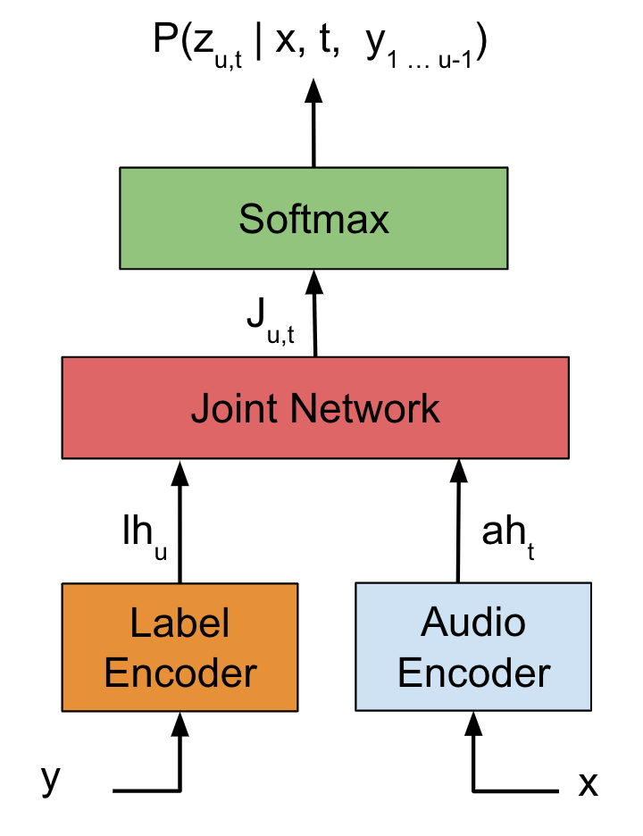
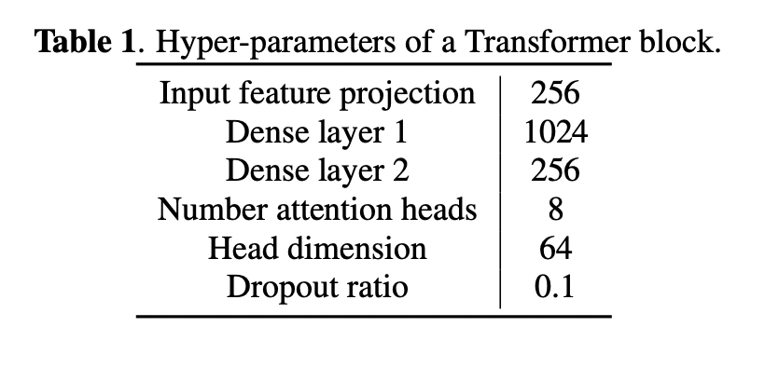
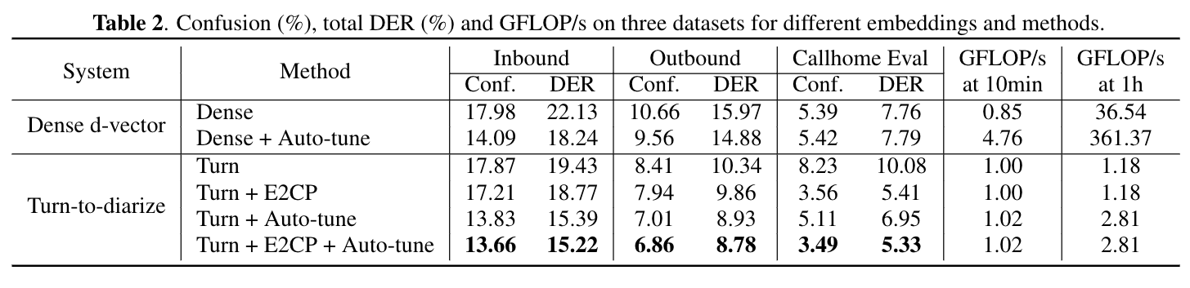
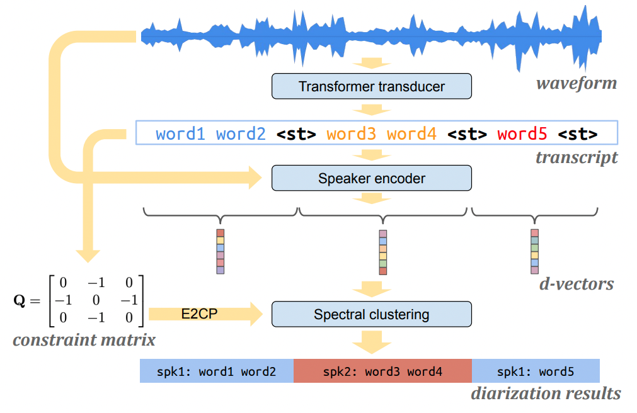
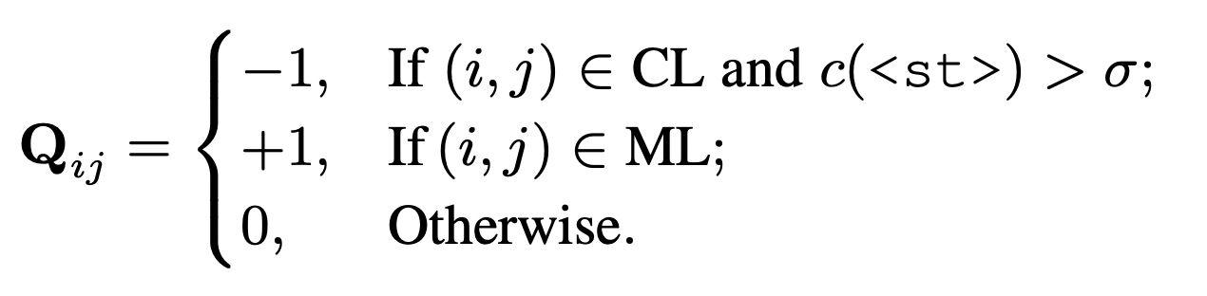
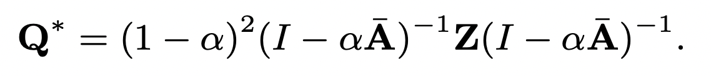
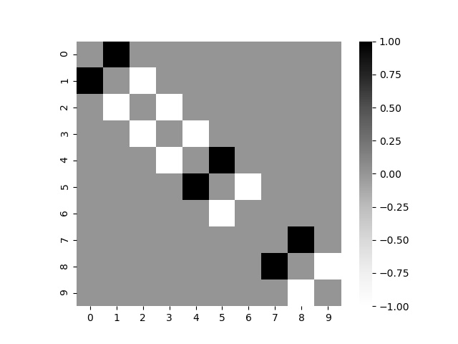
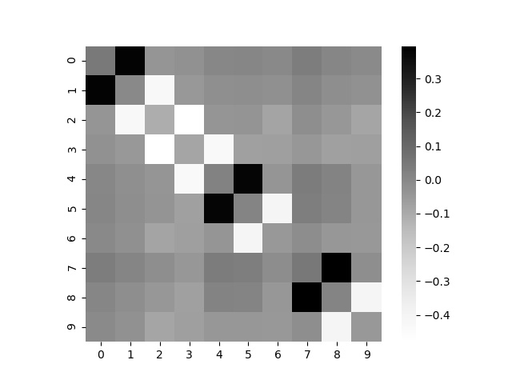
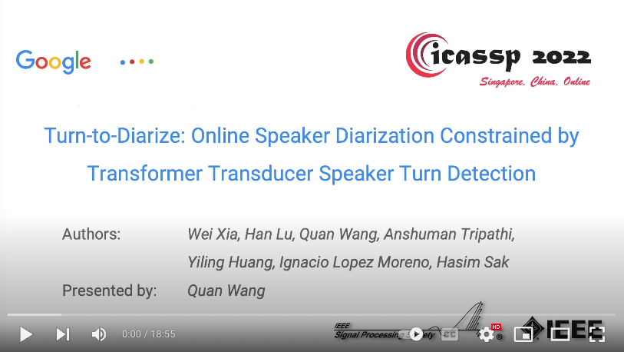
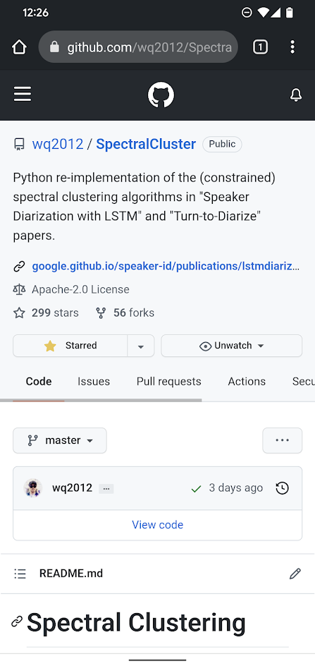






Problem with Supervised Diarization
Speaker Turn Detection
Experimental Results
Recently, supervised speaker diarization systems are becoming very popular, e.g. UIS-RNN, discriminative neural clustering, permutation invariant training
To train such systems, time-annotated speaker labels are required for the training data
This kind of annotation is extremely expensive and error-prone: single pass annotation of 10 min of audio takes about 2 hours!
Alternatively, annotating speaker turns only adds minimal incremental efforts on top of regular ASR transcribing
We treat speaker turn as a new special token <st>
Jointly trained with the ASR model
Audio encoder: 15 layers of transformer blocks
Output: 75 possible graphemes (including <st>, <sos>, <eos>)
Datasets:
Speaker turn detection training set: ~7500 hours of YouTube + public data
Speaker encoder training set: Vendor collected data (37 locales) + public data
Diarization eval set: “Outbound” telephone (2 speakers); “Inbound” telephone (2~10 speakers); Callhome American English (eval subset)
Metrics:
Quality: speaker confusion (Conf.) and diarization error rate (DER)
Efficiency: floating point operations to process 1s of audio (FLOP/s)
start: 0.0, end: 1.2, speaker: A
start: 1.3, end: 4.4, speaker: B
start: 6.7, end: 9.4, speaker: A
good morning <st>
morning how are you <st>
good what about you <st>
Time-annotated speaker labels
Speaker turns on top of ASR transcription
Fig. Transformer transducer.
System Overview
Turn-to-Diarize
Make use of speaker turn annotations that can be acquired at large scale
A transformer transducer for joint speaker turn detection and ASR
Compute turn-wise speaker embeddings
Constrain the unsupervised clustering algorithm with speaker turns
Speaker turn detection:
If a turn is longer than 6s, insert a fake turn
This compensates for false rejects
Speaker encoder:
Reset states at speaker turns, one embedding for each turn
This makes the sequence much shorter and clustering much cheaper!
Spectral clustering:
Few modifications from previous work – no Gaussian blur; thresholding with auto-tune; using Laplacian matrix
Apply a constraint matrix to the affinity matrix
Results:
“Dense d-vector” is extremely expensive for long-form speech – eigen-decomposition of a huge Laplacian matrix
Turn-to-diarize is more feasible for long-form speech – speaker turns are sparse, thus Laplacian matrix is very small, even after 1h of audio
Auto-tune and speaker turn constraints are critical for turn-to-diarize performance
Best turn-to-diarize significantly outperforms best “dense d-vector”
More Information
Full lecture is available on
Clustering algorithm on __________
https://github.com/wq2012/SpectralCluster
E2CP
Fig. Initial constraint matrix.
“Cannot-Link” (CL): segmented by true <st>;
“Must-Link” (ML): segmented by fake <st>.
Fig. Constraint matrix after Exhaustive and Efficient Constraint Propagation (E2CP).
Fig. System architecture of the speaker diarization system.

